Slide 1



Urban Data Centers in The Netherlands
Barteld Braaksma - CBS Innovation Manager

Slide 2


Why CBS Urban Data Centers ?
Results
Towards smart statistics
The challenging journey

Slide 3
Why CBS Urban Data Centers?
Results
Towards smart statistics
The challenging journey

Slide 4

Cities have many data related ambitions:
Data driven, fact and evidence based, open data,
big data, standardising data, (inter-) national benchmarking, smart cities
But cities lack access to national data and often lack data – expertise with regards to:
data science
data analytics
data integration
data visualisation
data management

Slide 5
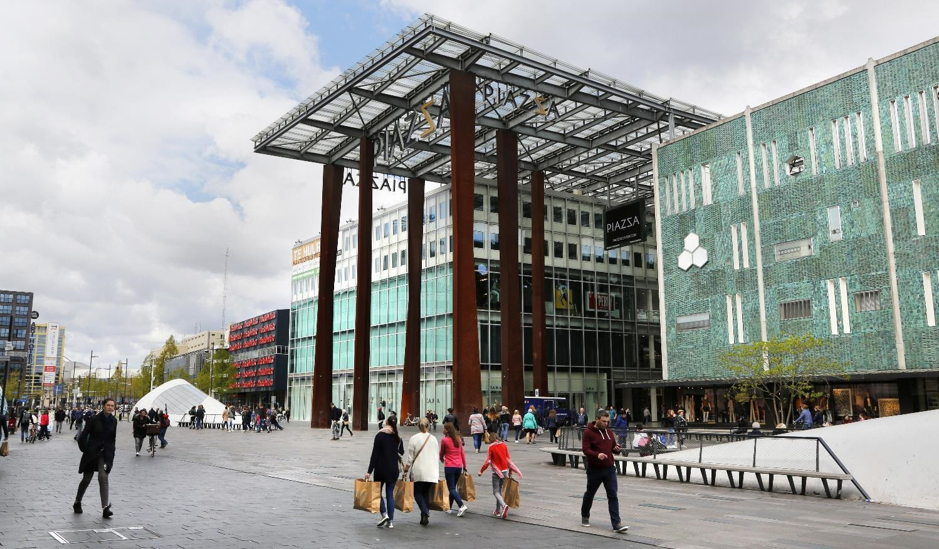
So…why did CBS create Urban Data Centers ?
To connect CBS data and CBS data-expertise to cities leading to:
  a better understanding of a city
  better (facts based & data driven) informed city decisions
  better city finances (smarter use of data can lead to substantial savings on city budgets)
  optimized, harmonized, standardized data local – regional – national - international

Slide 6
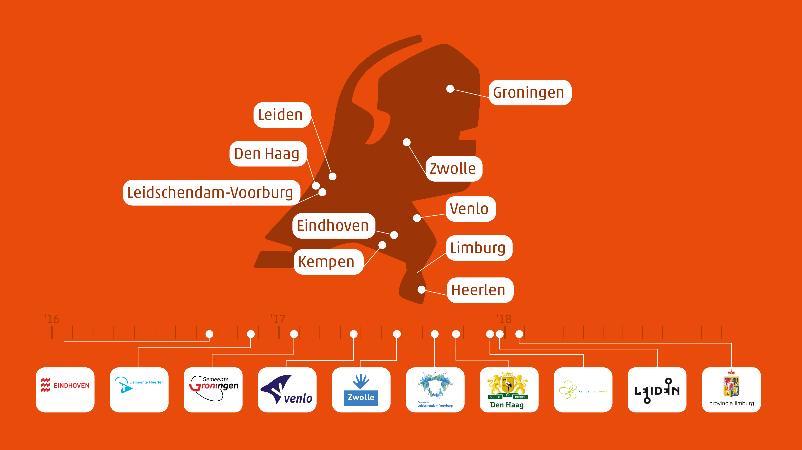
Rural data center
Provincial data center

Slide 7
Why CBS Urban Data Centers ?
Results
Towards smart statistics
The challenging journey

Slide 8
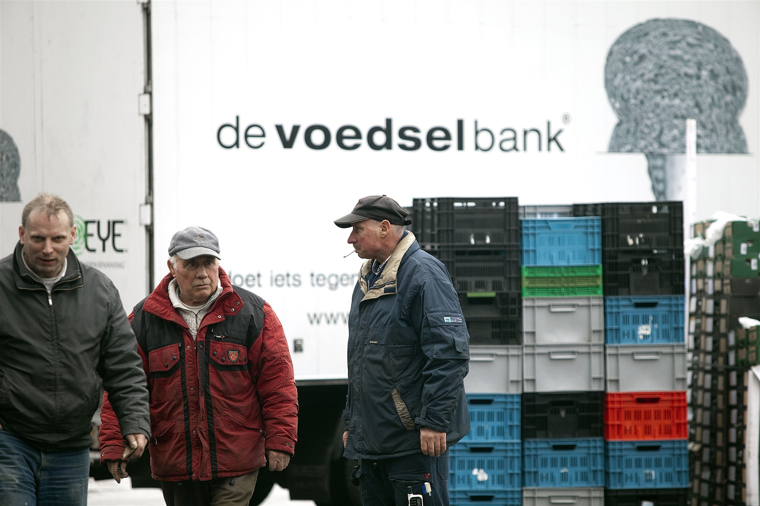
Data may lead to better insights and better spending of city finances:
combining and integrating data may help
to fight city poverty and realise savings on city social welfare budget
Leegstandsbepaling op basis van basisregistraties

Slide 9

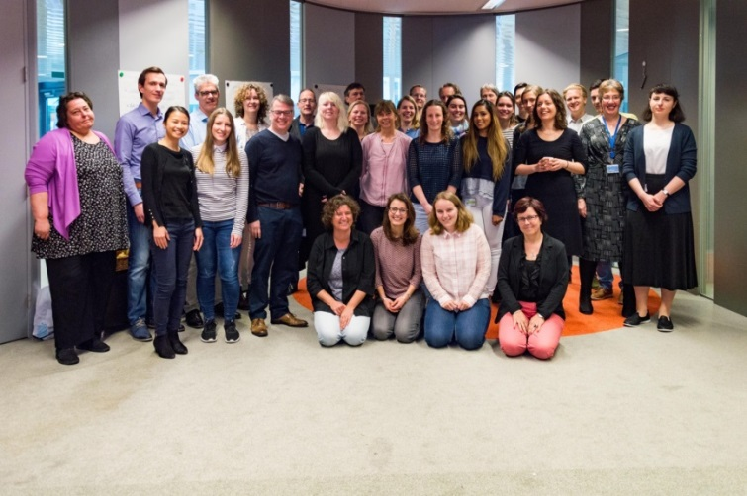



Data Camp The Hague innovative collaboration model before launch of UDC The Hague (March 2017)
30 researchers, four organisations
8 research questions related to poverty
Working in secure closed environment
  CBS microdata
  The Hague microdata
  Social media, online election programs
  Very successful, but
  Far too little time and data…☹

Slide 10
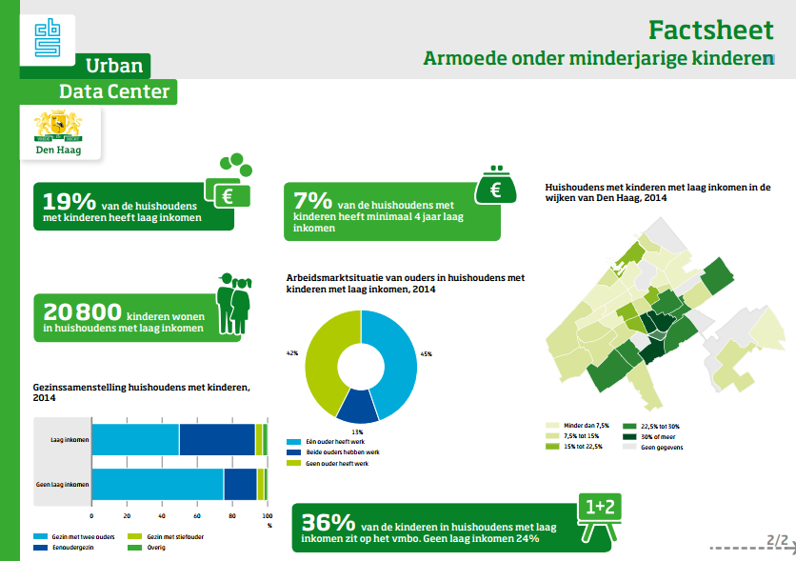
Poverty among children
in The Hague
Information on
Children affected
Parents’ work
Family situation
Education level
Living environment
Duration
Information presented at the opening of UDC The Hague, September 2017
as part of a Fact Sheet
inspired by results from the data camp
Leegstandsbepaling op basis van basisregistraties

Slide 11
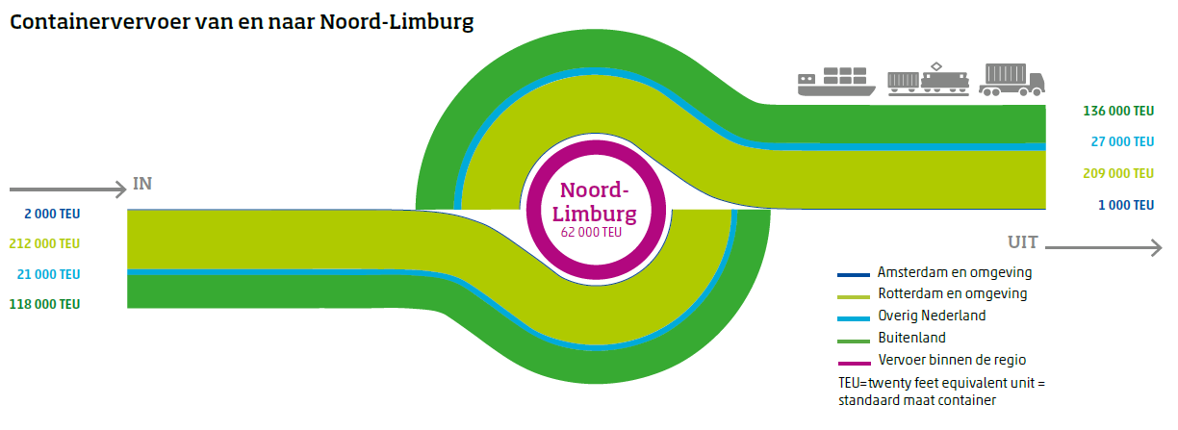
Better understanding cross national border transportation of goods (used for citymarketing)
Urban
Notes:
Zelfde plaatje voor containers:
Verbinding Rotterdam-Venlo is cruciaal

Slide 12
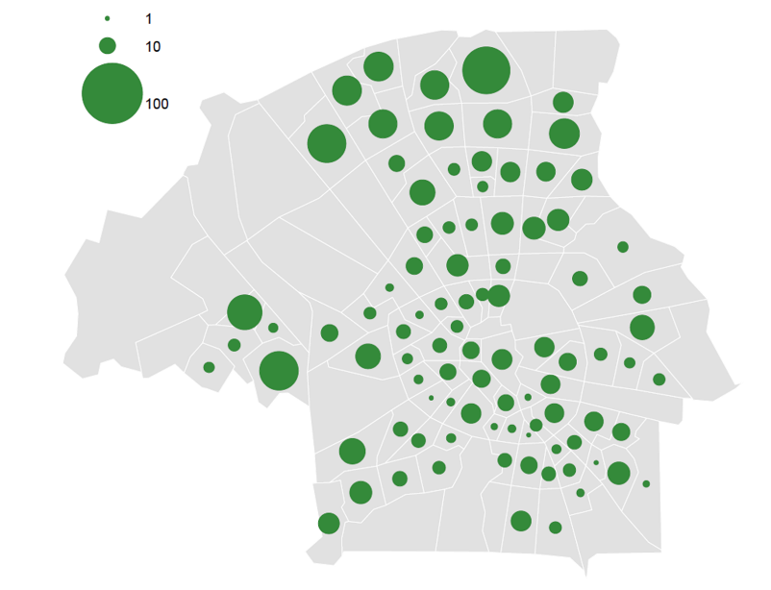
Data driven (investment) decision making in UDC Eindhoven
Where are the electric cars?
Information used to install charging stations for electric cars in the right places

Slide 13
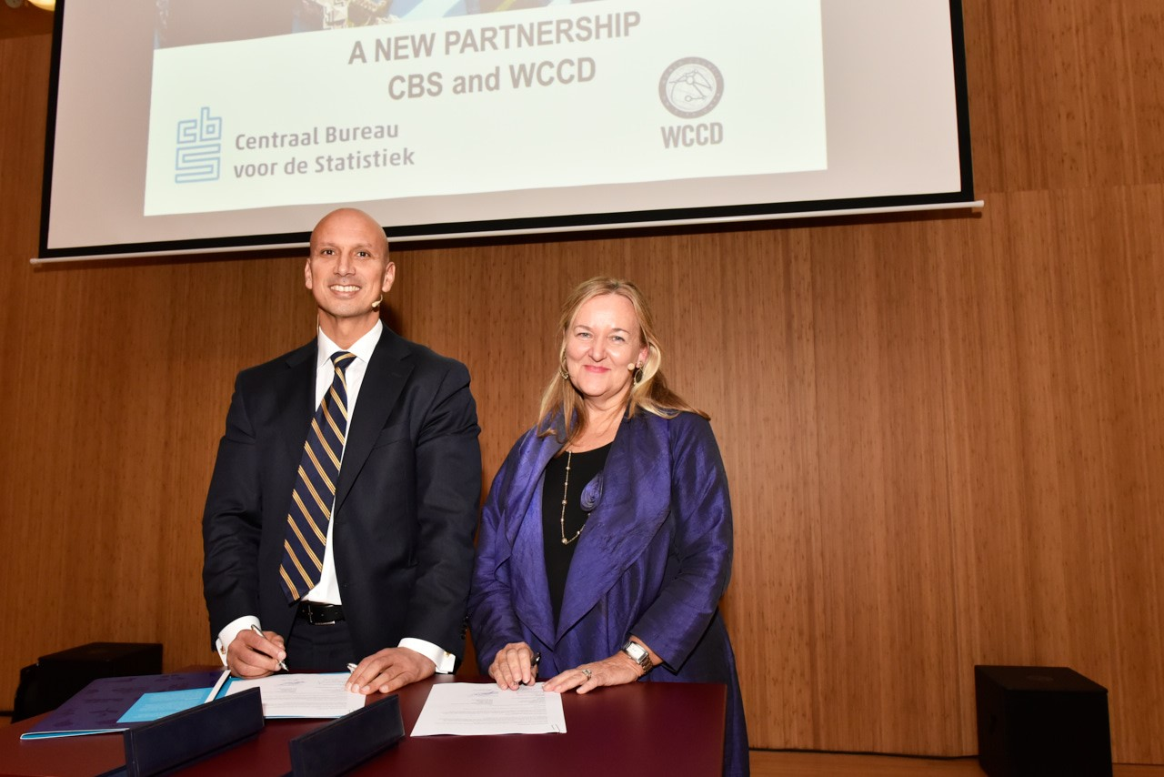
Through collaboration with the World Council on City Data (since 2016)
city and national data are increasingly
standardized and harmonized with global data
Leegstandsbepaling op basis van basisregistraties

Slide 14
Why CBS Urban Data Centers ?
Results
Towards smart statistics
The challenging journey

Slide 15
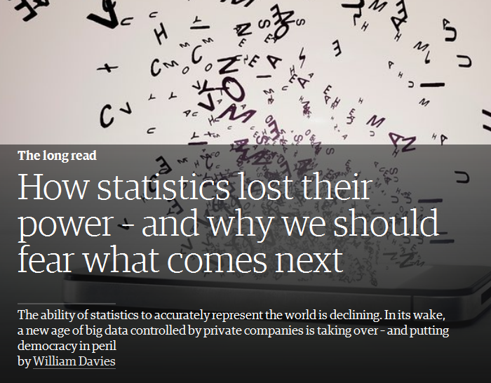
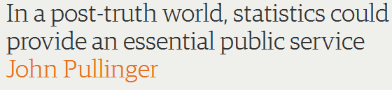



Is the time of statistics over?
CBS answer:
Center for Big Data Statistics
(connected to UDCs)
https://www.theguardian.com/politics/2017/jan/19/crisis-of-statistics-big-data-democracy

Slide 16










































CBDS approach: partnering!
Academic, public, private partners
Both national and international
Various relationships

Slide 17
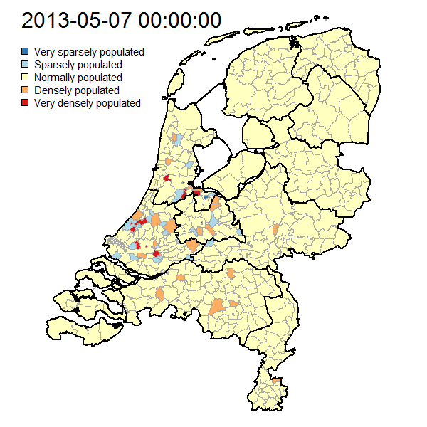



Daytime population based on mobile phone data
Which level of detail?
How to present?
Is it useful?

Slide 18

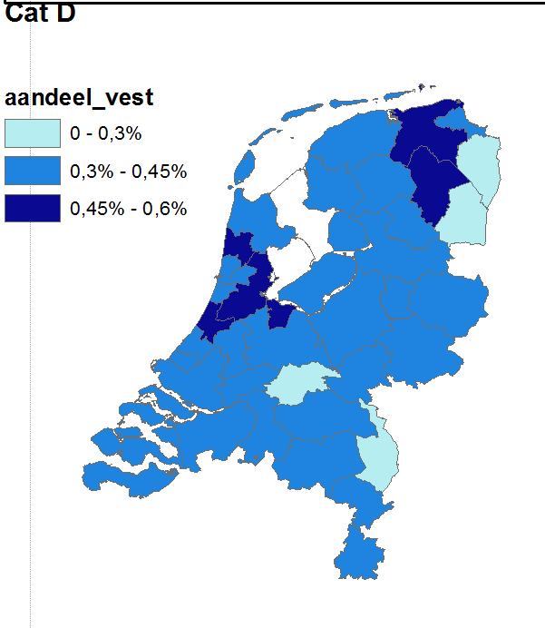
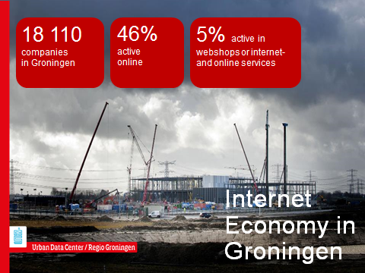
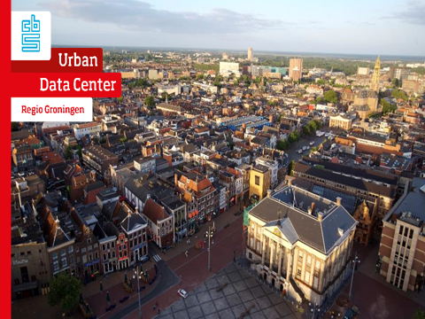


Measuring the internet economy
in The Netherlands- and Groningen
Main research question:
“What is the importance of the internet to the Dutch economy?”
The aim of the research project was fourfold:
Determine a pragmatic definition of “the internet economy”
Show the importance and size of the internet economy in NL
Show the possibilities of new measurement methods
Explain differences from regular statistics/concepts
2.5 million Dutch websites
linked to business register

Slide 19
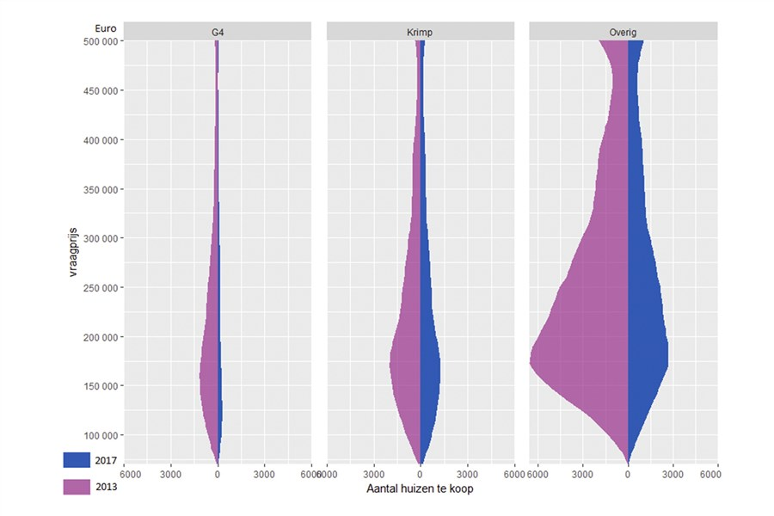
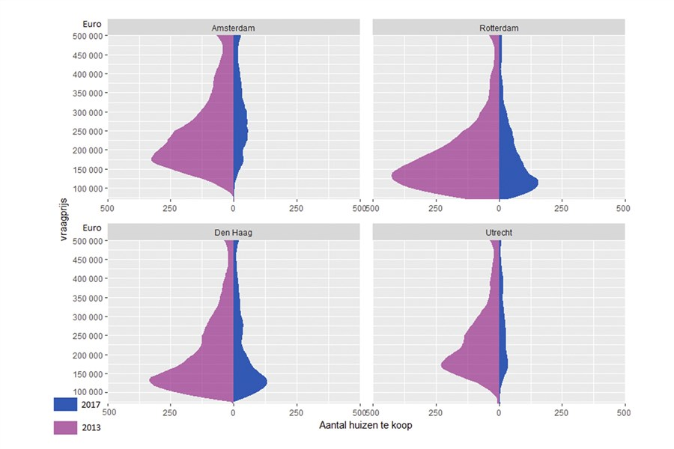

The online housing market in The Netherlands
Four largest cities (G4)
Shrinking regions
The rest of the country
Number of houses for sale online, 2013+2017
Source:

Slide 20
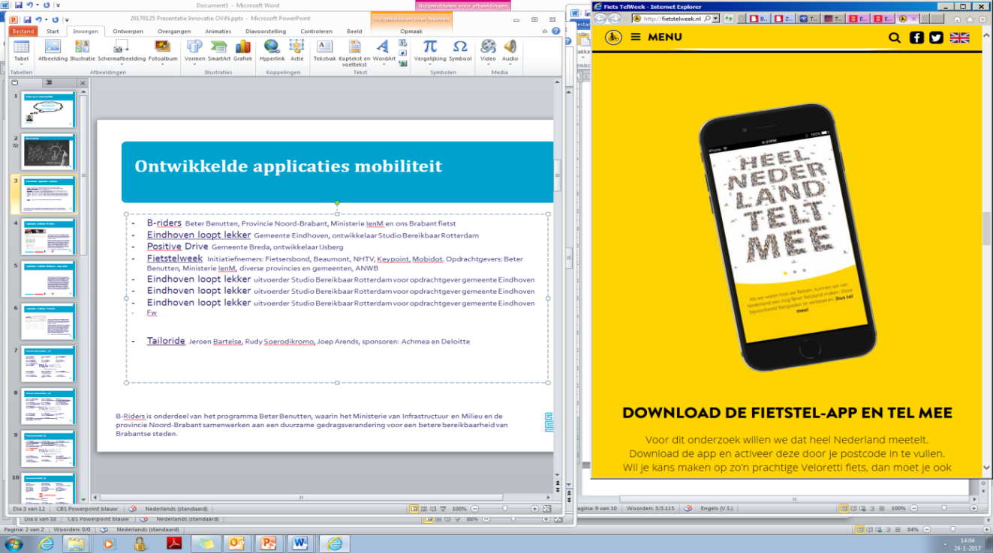
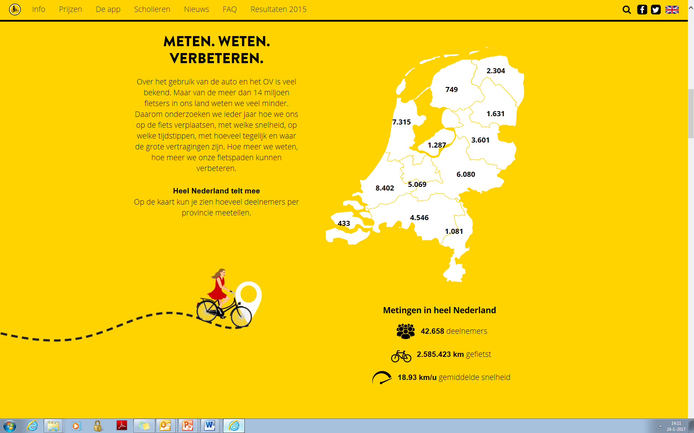
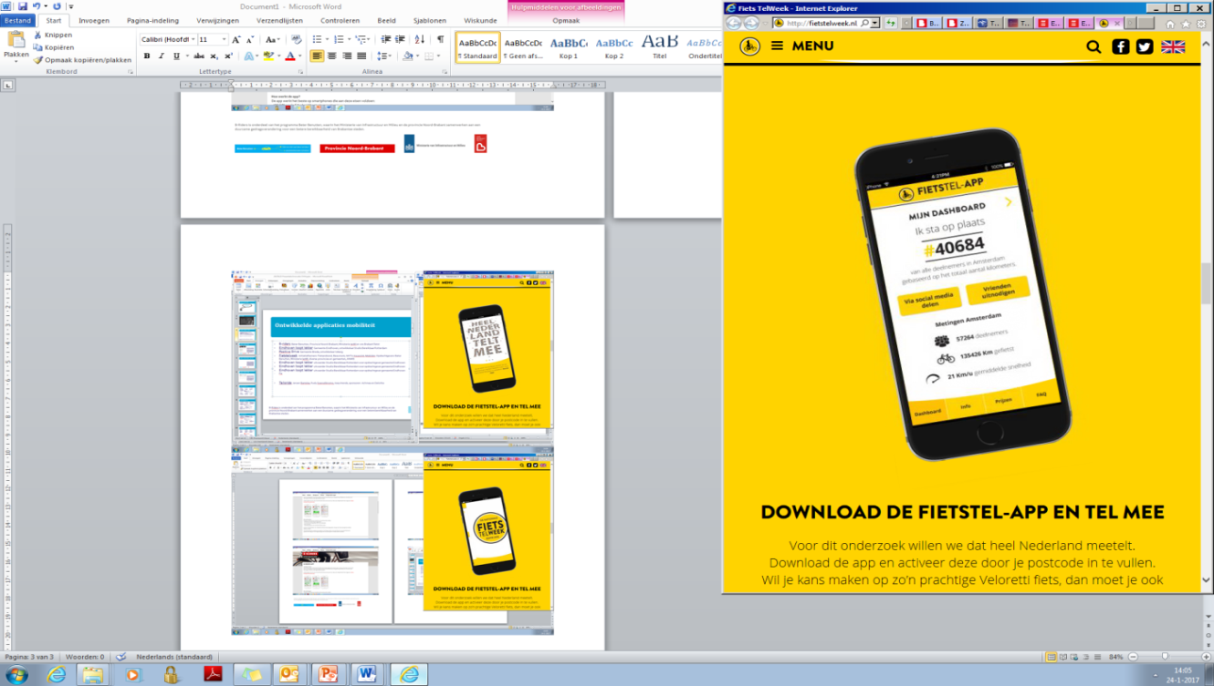

National Bicycle Counting Week 18-24 September 2017
Can we turn this into statistics?

Slide 21
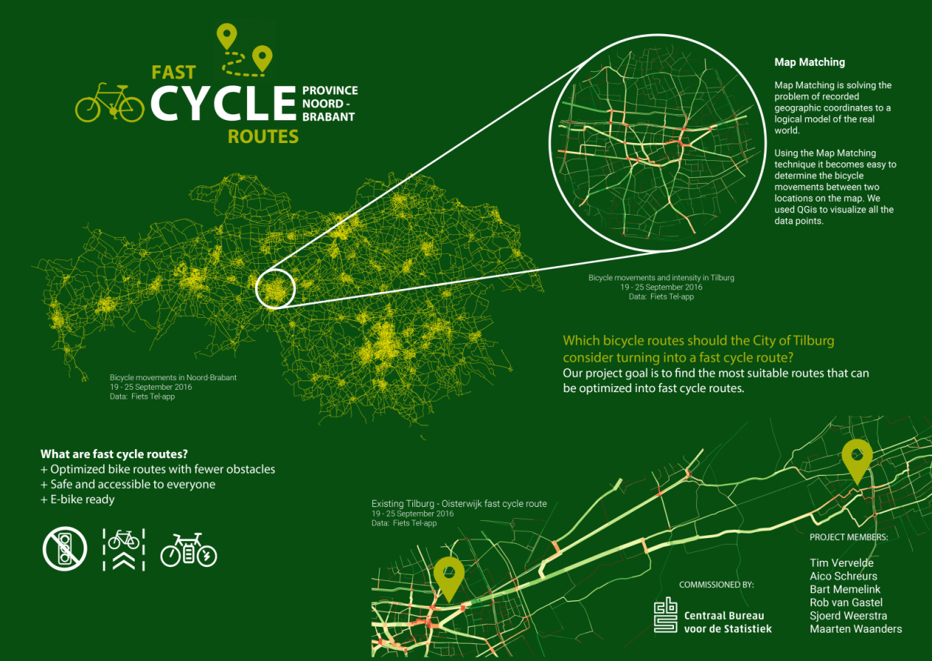

National Bicycle Counting Week 18-24 September 2017
Yes we can! See also the website

Slide 22
Why CBS Urban Data Centers ?
Results
Towards smart statistics
The challenging journey

Slide 23

Leegstandsbepaling op basis van basisregistraties

Slide 24

Leegstandsbepaling op basis van basisregistraties

Slide 25


Slide 26
Creating and implementing CBS Urban Data Centers is a challenging journey, not ‘’a walk in the park’’

Slide 27
Facts that matter

